Slide 1
Individual project-Based Image Processing Assignment Color Transfer Between Images
S.Y.D.Senadheera
21/ENG/128

Slide 2
Introduction
This project involves applying color transfer techniques to images using Python. The main goal is to transfer the color characteristics of a target image to a source image, achieving a visually appealing transformation. The project processes five pairs of images, calculates mean and standard deviation in the LAB color space, and applies the color transfer algorithm to generate the desired results. The outputs are saved and displayed for comparison

Slide 3
What is color transfer ? A technique that alters the colors of a source image to match the color palette of a target image
Where is it used? Photography
Enhance aesthetics, correct imbalances, and match themes
Film production
Maintain continuity, achieve grading, and unify schemes.
Graphic design
Create cohesive designs, harmonize colors

Slide 4
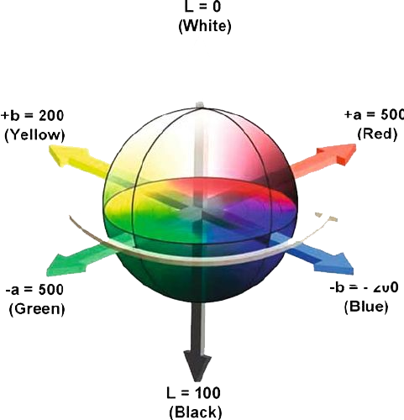
Methodology
LAB Color Space:
LAB color space separates lightness (L) from color components (A and B).
L channel represents lightness.
A and B channels color components ranging from green-red and blue-yellow, respectively.
This separation allows for more precise color manipulation.
Why Mean and Standard Deviation?
Mean: Measures the average color value across all pixels in an image channel.
Standard Deviation: Measures the spread of color values around the mean, indicating the color contrast.
Application in Color Transfer:
Calculate mean and standard deviation for each channel (L, A, B) in both source and target images.
Transfer the normalized values to match the target image's color distribution.

Slide 5
Libraries.
NumPy
OpenCV
Tkinter
Matplotlib
Threading
OS
PYInstaller
Datasets.
Source images
Target images
Tools.
Python
Tkinter GUI Elements
File Dialogs
Integrated Development Environment (IDE)-’VScode’
Image Viewer
Command Line or Terminal

Slide 6
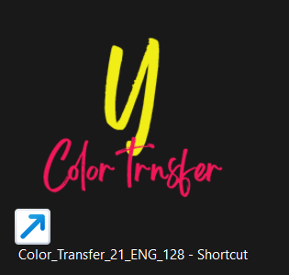
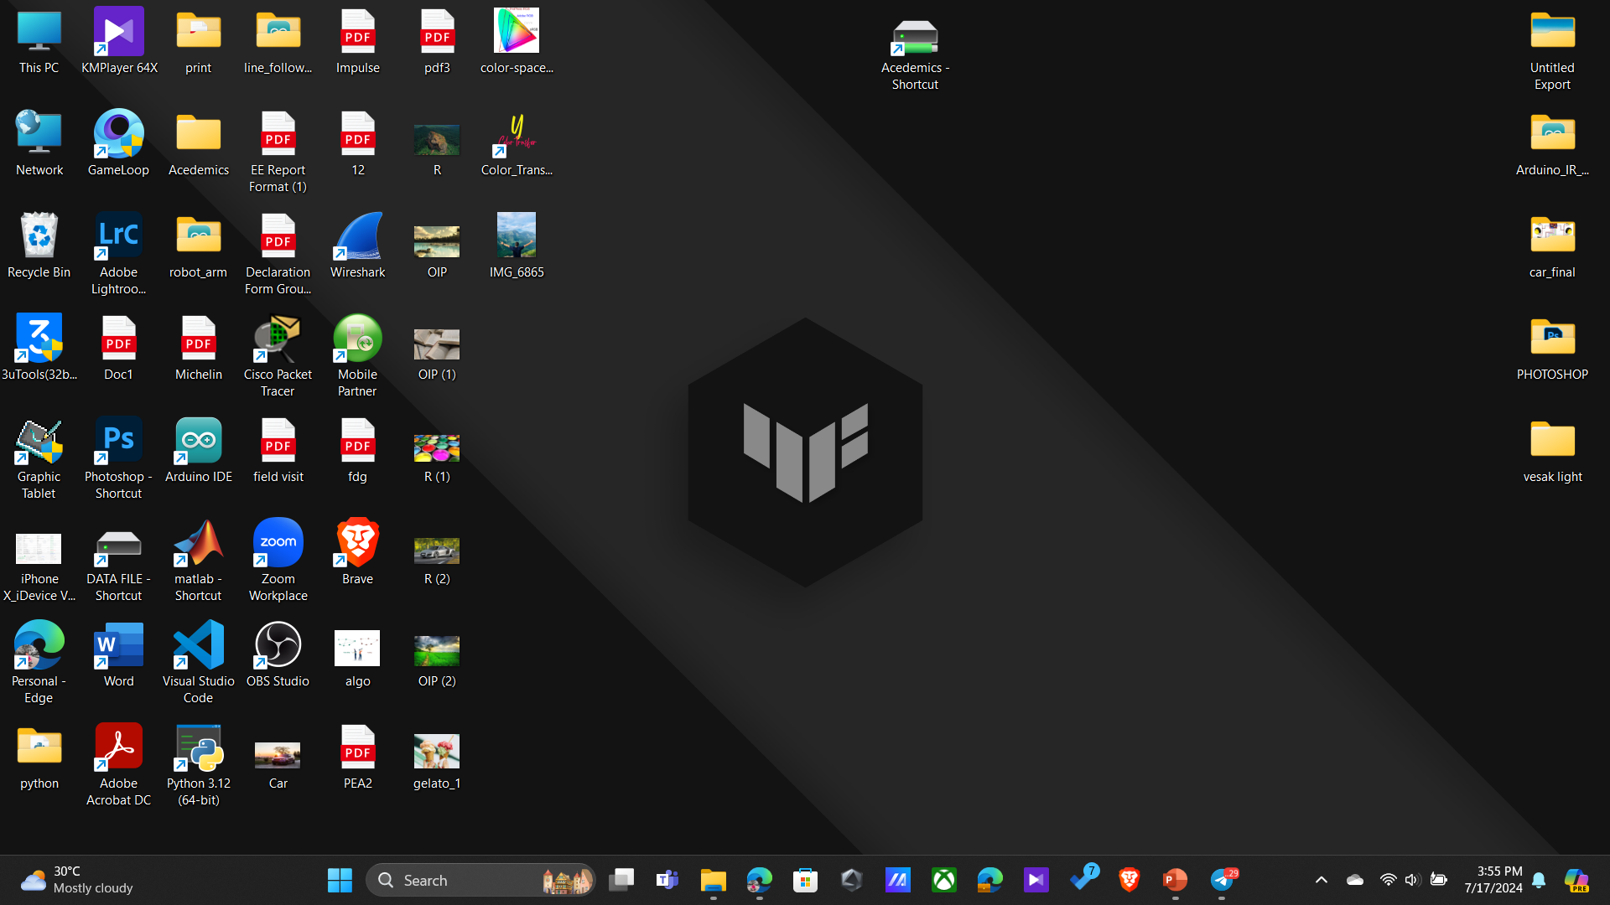
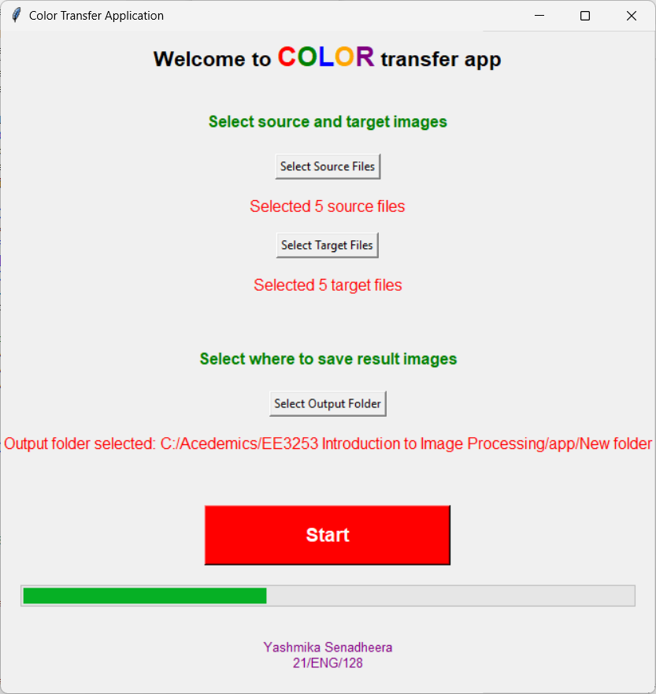
DESKTOP SOFTWARE
Can select source and target image by easily pressing the buttons and can get the output results save into a required folder

Slide 7
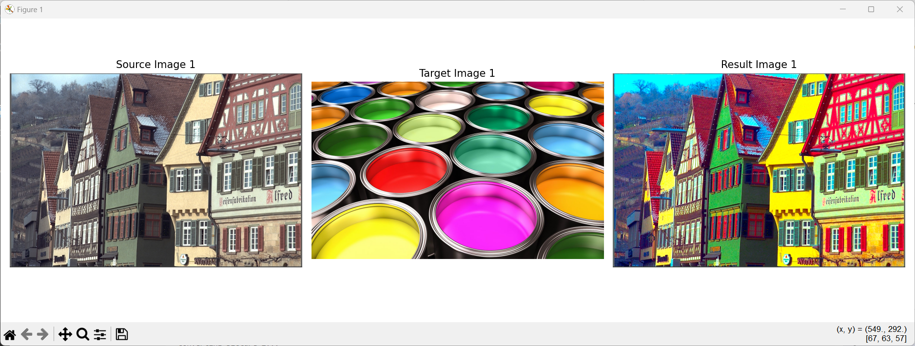
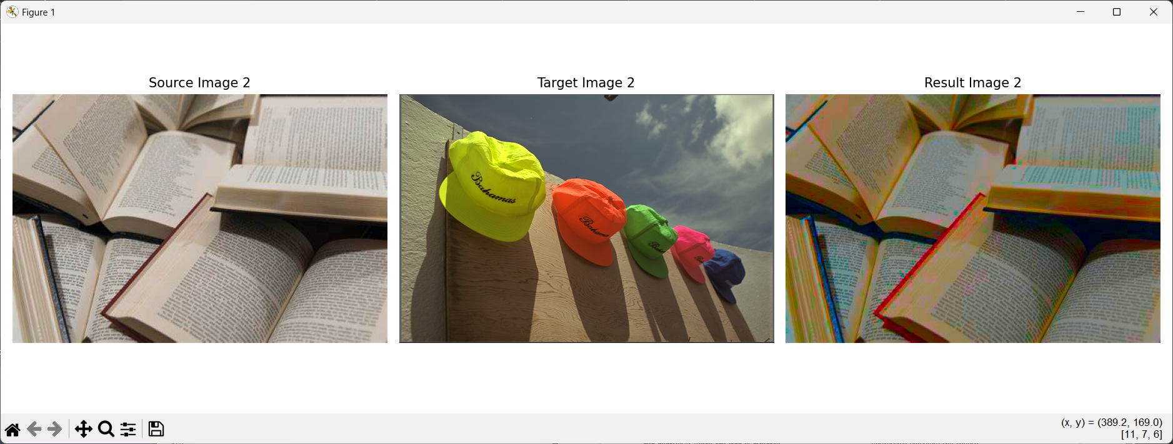
Results
01
02

Slide 8
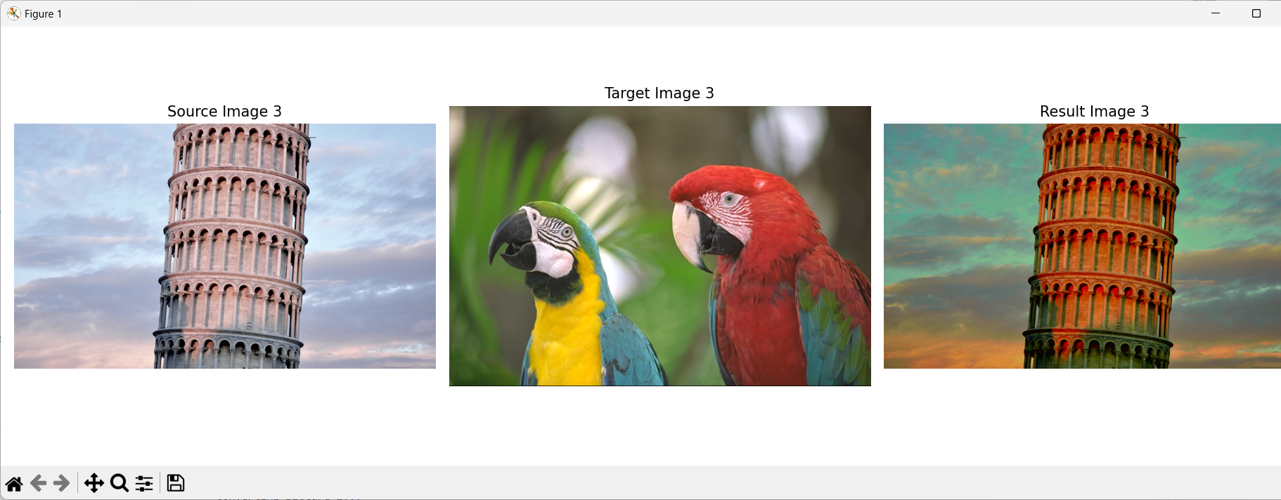

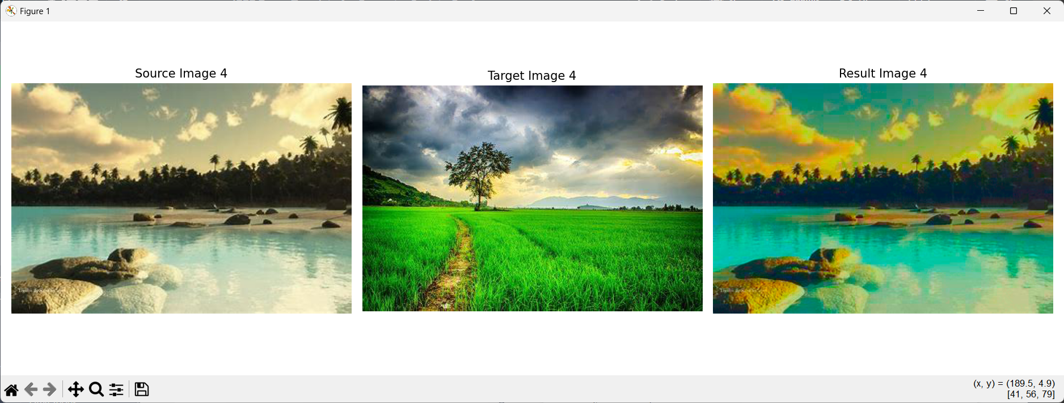

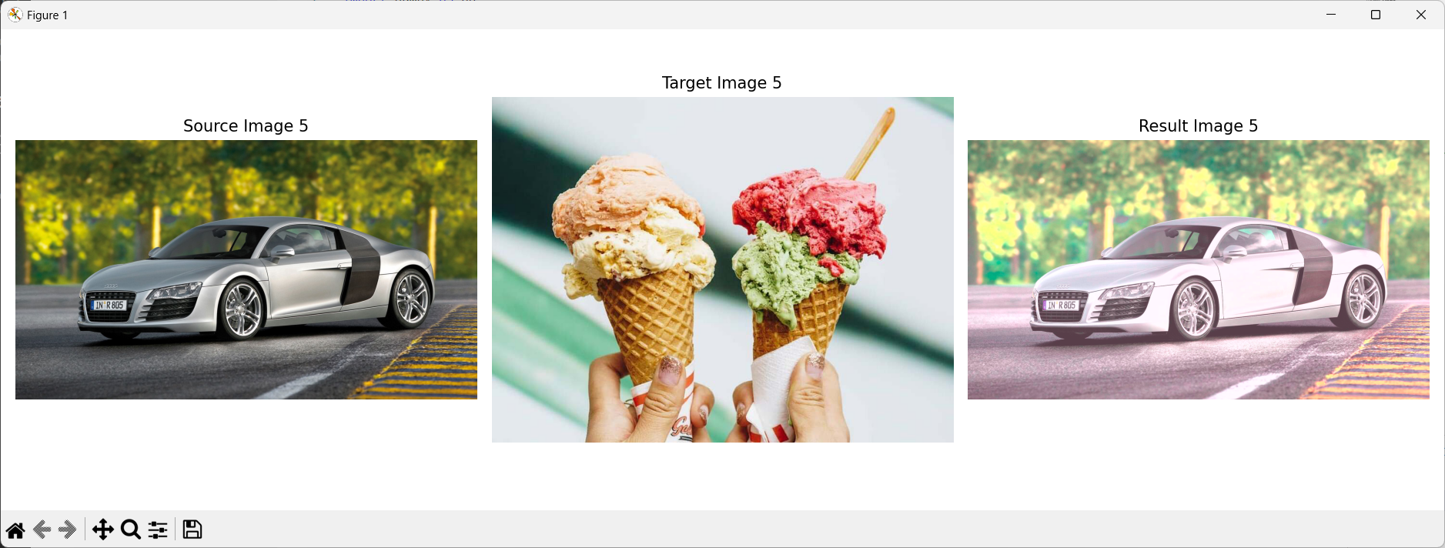

MORE
RESULTS

Slide 9
Conclusion
Outputs:
Successfully applied color transfer to five images.
Achieved desired color characteristics in the resulting images.
Demonstrated the practical use of mean and standard deviation calculations in the LAB color space.
Challenges:
Handling different image formats (BMP, JPG, JPEG) and converting them appropriately.
Ensuring consistent color transfer across images with varying lighting and color conditions.
Managing computational efficiency and processing time for larger images

Slide 10
THANK YOU
Q&A

